Slide 1
BASH SCRIPTING
PRESENTED BY SYED SHAKEEL AHAMED

Slide 2
WELCOME TO OUR TODAY'S PRESENTATION

Slide 3
Agenda
1.Introduction
2.Basic Bash Syntax
3.Working with Files and Directories
4.Functions and Script Execution
5. Advanced Topics

Slide 4
1. Introduction to Bash Scripting
2.What is Bash scripting?
3.Why use Bash for automation?
4.Common use cases in system administration and DevOps.

Slide 5


Slide 6
What is Bash scripting? Bash is a command-line interpreter or Unix Shell and it is widely used in Linux Operating System. It is written by Brian Jhan Fox. It is used as a default login shell for most Linux distributions.
Scripting is used to automate the execution of the tasks so that humans do not need to perform them individually.
Bash scripting is a great way to automate different types of tasks in a system. Developers can avoid doing repetitive tasks using bash scripting.
Bash is like a robot assistant for your computer. It lets you control your Linux/Unix system by typing commands (e.g., ls to list files). Instead of doing tasks manually, you can write a Bash script—a text file with commands—to automate things like organizing files, installing software, or backing up data

Slide 7
Why use Bash for automation? Bash is a powerhouse for automation because it’s simple, efficient, and deeply integrated with Unix/Linux environments.
Bash is built into most Linux distributions, making it easily accessible for system administrators and developers.
Unlike heavier scripting languages, Bash runs natively in the shell, minimizing resource consumption and execution time.
You can seamlessly combine Bash with Unix commands (grep, sed, awk, curl, etc.) to process text, manage files, and interact with APIs.
Excellent for System Automation
- Automates tasks like user management, backups, log rotations, and security audits.
- Example:
tar -czf /backup/system_$(date +%F).tar.gz /etc /home /var
Script Scheduling with Cron
- Bash integrates smoothly with cron, enabling scheduled automation for repetitive tasks.
- Example:
0 2 * * * /home/user/backup.sh # Runs the script every day at 2 AM
Ideal for AWS & DevOps Automation
- Can automate AWS services using CLI commands, handling tasks like launching EC2 instances or managing S3 buckets.
- Example:
aws s3 sync /local/path s3://my-bucket --delete

Slide 8
Common use cases in system administration and DevOps Bash scripting plays a crucial role in system administration and DevOps, helping automate repetitive tasks and streamline operations. Here are some common use cases:
User and Permission Management
Automate user creation and permission assignments.
while read user; do
useradd "$user"
echo "$user:password123" | chpasswd
done < users.txt
Automated Backups & Log Management
Schedule regular backups of configurations, databases, or logs.
Rotate logs to prevent excessive disk usage.
tar -czf /backup/config_$(date +%F).tar.gz /etc
find /var/log -type f -name "*.log" -mtime +7 -exec rm {} \;
AWS & Cloud Automation
Automate AWS CLI tasks like S3 bucket management, IAM policies, and EC2 instance scaling.
aws s3 sync /data s3://my-bucket --delete
aws ec2 start-instances --instance-ids i-12345678
Scheduled Task Execution
Use cron to schedule scripts for regular execution.
0 1 * * * /home/user/backup.sh # Run backup script daily at 1 AM

Slide 9
Basic Bash Syntax How to Write Your First Bash Script
Let’s create a simple script that says "Hello, World!":
First, we will create a file with the .bash extension.
Next, we will write down the bash scripts within it
After that, we will provide execution permission to it.
1. Create a Script File:
vi hello.bash
2. Add code
#!/bin/bash
echo "Hello world"
3. Make it Executable
chmod +x hello.bash
4. Run ./hello.bash
#!/bin/bash Age=17 if [ "$Age" -ge 18 ]; then echo "You can vote" else echo "You cannot vote" fi

Slide 10
Scripting Standards :
Always create a directory to store scripts
Script name should identify the function/script usage
Script should end with .shell
All scripts to be executed should have proper executable file permissions.
Script should have certain format, it help us to understand easily
1.Define shell - #!/bin/bash (shebang characters)
2. Comments (##) - help us to understand what we are doing
3. Define Variables – used as container/ Store anything and make our scripts more generic instead of hard coding
4. Command – echo, cp grep
5.Statments - If, while, for etc.
The SEQUENCE OF THE SCRIPT FROM
TOP TO BOTTOM ONLY
read--- input string command
echo - to print the output

Slide 11
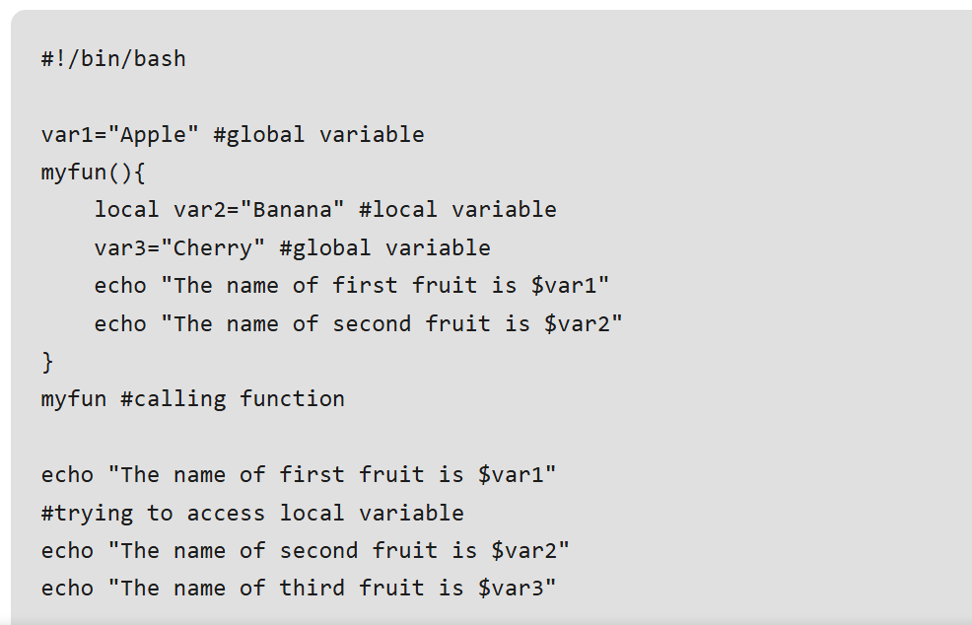
Key Concepts of Bash Scripting File Names and Permissions
Variables in bash There are two types of variables present within Bash Scripting. Conventionally, If a variable, is declared inside a function then it is generally a local variable and if it is declared outside then I t is a global variable. In the case of a bash script, this concept is a little bit different, here any variable whether it is written inside a function or outside a function by default is a global variable. If we want to make a local variable then we need to use the keyword "local"

Slide 12
Decision Making in bash -- 2 types of decision-making statements are used in bash scripting
1. If-else statement:
2. case-sac statement:
If else statement is a conditional statement. It can be used to execute two different codes based on whether the given condition is satisfied or not.
There are a couple of varieties present within the if-else statement. They are -
if-fi
if-else-fi
if-elif-else-fi
nested if-else
case-sac is basically working the same as switch statement in programming.
Syntax of case-sac statement:
case $var in Pattern 1) Statement 1;; Pattern n) Statement n;; esac
Example:
Name="Satyajit" case "$Name" in #case 1 "Rajib") echo "Profession : Software Engineer" ;; #case 2 "Vikas") echo "Profession : Web Developer" ;; #case 3 "Satyajit") echo "Profession : Technical Content Writer" ;; esac
Output : Profession : Technical Content Writer

Slide 13
String and Numeric Comparisons Arithmetic Operators
Operator | Description
-eq | Equal
-ge | Greater Than or Equal
-gt | Greater Than
-le | Less Than or Equal
-lt | Less Than
-ne | Not Equal
Operator | Description
== | Returns true if the strings are equal
!= | Returns true if the strings are not equal
-n | Returns true if the string to be tested is not null
-z | Returns true if the string to be tested is null

Slide 14
Bash Scripting - For Loop Depending on the use case and the problem it is trying to automate, there are a couple of ways to use loops Simple For loop
Range-based for loop
Array iteration for loops
C-Styled for loops
Infinite for loop
Range-based for loop
#!/bin/bash for n in {1..5}; do echo $n done
#!/bin/bash for n in {1..5..2}; do echo $n done
Array iteration for loops
#!/bin/bash s=("football" "cricket" "hockey") for n in ${s[@]}; do echo $n done
C-Styled for loops
#!/bin/bash n=7 for (( i=1 ; i<=$n ; i++ )); do echo $i done
Simple For loop
To execute a for loop we can write the following syntax:
#!/bin/bash for n in a b c; do echo $n done
In the first iteration, n takes the value "a", and the script prints "a".
In the second iteration, n takes the value "b", and the script prints "b".
In the third iteration, n takes the value "c", and the script prints "c".
Infinite for loop
#!/bin/bash n=4 for (( ; ; )); do if [ $n -eq 9 ];then break fi echo $n ((n=n+1)) done

Slide 15
Bash Scripting - While Loop A while loop is a control flow statement in Bash scripting that allows a certain block of code to be executed repeatedly as long as a specified condition is true. The loop provides a way to automate repetitive tasks and is a fundamental construct in scripting and programming.
The Syntax of a while loop in BASH Scripting
while [ condition ]; do # statements # commands done
#!/usr/bin/bash
a=7 while [ $a -gt 4 ]; do echo $a ((a--)) done echo "Out of the loop"
#!/usr/bin/bash
file=temp.txt while read -r line; do echo $line done < "$file"
#! /bin/bash
file=wh.txt echo "Enter the content into the file $file" while read line do echo $line >> $file done
#!/usr/bin/bash
i=1 while : do echo $i if [ $i -eq 20 ]; then echo "This is the end of the loop" break fi ((i++)) done

Slide 16
Bash Scripting – Array Arrays allow us to store and retrieve elements in a list form which can be used for certain tasks. In bash, we also have arrays that help us in creating scripts in the command line for storing data in a list format. Creating Arrays
To create a basic array in a bash script, we can use the declare -a command followed by the name of the array variable you would like to give. #!/bin/usr/env bash declare -a sport=( [0]=football [1]=cricket [2]=hockey [3]=basketball )
#!/bin/usr/env bash declare -a sport=( [0]=football [1]=cricket [2]=hockey [3]=basketball ) echo "${sport[@]}"

Slide 17
Special Variables
Internal variables or Preset variables | Description
$# | How many command line parameters were passed to the script.
$@ | All the command line parameters are passed to the script.
$? | The exit status of the last process to run.
$$ | The Process ID (PID) of the current script.
$USER | The username of the user executing the script.
$HOSTNAME | The hostname of the computer running the script.
$SECONDS | The number of seconds the script has been running for.
$RANDOM | Returns a random number.
$LINENO | Returns the current line number of the script.

Slide 18
Working with Files and Directories
Creating and Removing Files & Directories
mkdir my_folder
touch my_folder/my_file.txt
rm -rf my_folder
Finding and Deleting Old Files
find /logs -type f -mtime +7 -exec rm {} \;
Checking If a File or Directory Exists
If [[ -f "my_file.txt" ]]; then
echo "File exists!"
else
echo "File not found!"
Fi
if [[ -d "my_folder" ]]; then
echo "Directory exists!"
else
echo "Directory not found!"
Fi
Moving and Copying Files
mv my_file.txt /destination_folder/
cp my_file.txt /backup_folder/
Looping Through Files in a Directory
for file in my_folder/*; do
echo "Processing $file"
Done

Slide 19
Exit Codes
$? = is the Exit status of the most recently –executed command
$#= Total number of command line arguments passed
$*= It’s a space separated string of all arguments
$@= Stores all the arguments that we entered on the command line
File Operations
-s file exists and is not empty
-f file exists and is not a directory
-d directory exists
-x file is executable
-w file is writable
-r file is readable
Comparisons:
-eq equal for numbers
== equal for letters
-ne not equal to
!== not equal to for letters
-lt less than
-le less than or equal to
-gt greater than
-ge greater than or equal to

Slide 20
Real-world, live scenarios
EC2 Instance Bootstrap on Launch
--When launching an EC2 instance, a Bash script is used as User Data to configure the instance:
Resource CleanupLog Aggregation and Upload
-- Automatically delete unattached EBS volumes to save cost.
Automated Backups to S3
--Daily database dump and backup using cron + bash
Monitoring & Health Checks
Run a health check every minute; if app is down, restart it and send an SNS alert.
Application Deployment
Pull from Git, restart service
Log Aggregation and Upload

Slide 21
What is a Cron Job?
A cron job is a scheduled task that runs automatically at specified intervals on Unix/Linux systems. It is managed by a background service called the cron daemon (crond)
How this mechanism works : There are 2 parts to this process. 1) A cron process ( or daemon) is running in the back ground that executes the scripts 2) Each user in the system has a table called crontab that will define what jobs need to be executed.
How to see the crontab : ( Or crontab related commands ) list crontab - crontab -l edit crontab - crontab –e remove crontab - crontab -r

Slide 22
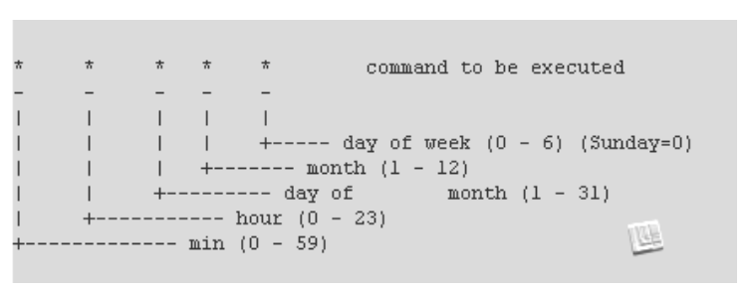
How to schedule a cron job General Syntax : Frequency Command STDOUT STDIN How to Define Frequency : Frequency of the a job is defined by 5 fields. Each file is as shown in the below diagram.
0 2 * * * tar -czf /backup/etc-$(date +\%F).tar.gz /etc
-- back up daily at 2 AM

Slide 23


Slide 24

THANK YOU

